Slide 1

EDA OF INCREASE IN GLOBAL TEMPARATURE MONTHWISE EVERY YEAR
Name- Manisha Karnati

Slide 2
OVERVIEW:
Problem Statement of EDA
EDA information
Graphs and Conclusion
Recommendations

Slide 3
Problem Statement:
This file consists of data regarding increase in data each month from 1880 to 2022.
The increase in temperature was due to gradual increase in the global warming.
The most important cause for global warming the start of industrial revolution in the mid 1800s to 1900s.
In this EDA, we analyzed the data for period of last ten years, during which month the increase in global temperature was more, what were its causes, consequences and solutions to the cause.

Slide 4
Impacts:
Increase in rising sea levels.
Health impacts
Extreme weather events
Loss of biodiversity

Slide 5
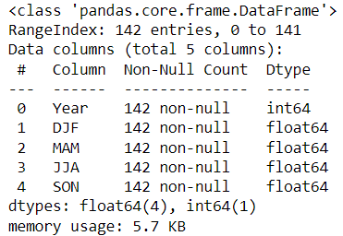
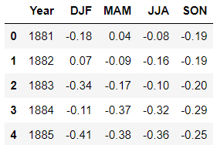
EDA Info:

Slide 6
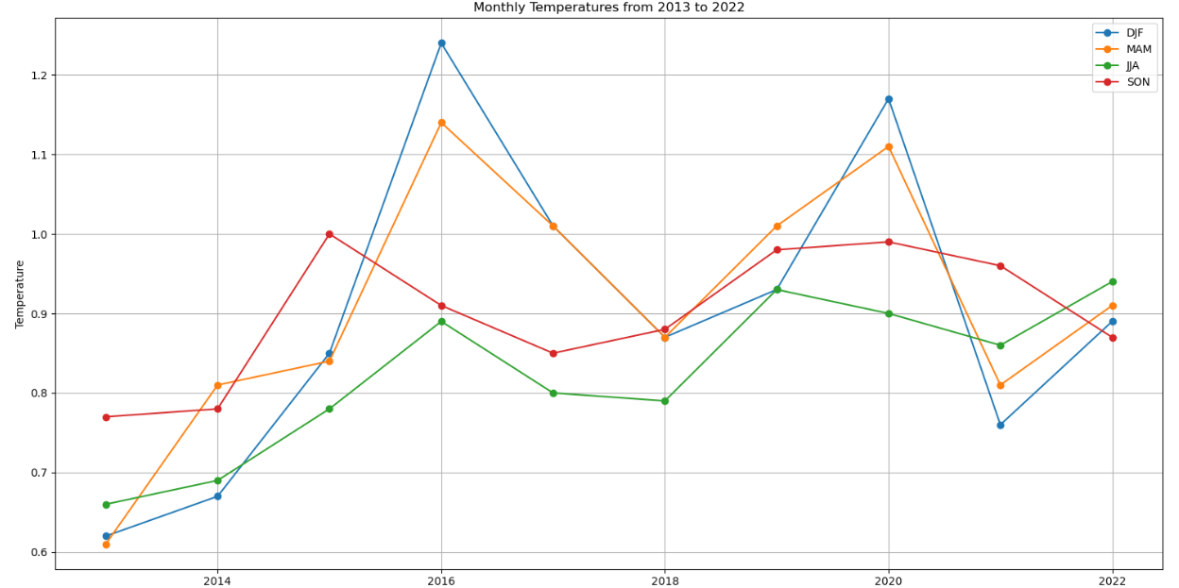
Graphs:

Slide 7
Conclusions:
For the period from 2013 to 2016, 2018 to 2021 there was significant rise in the global temperature for the months of Dec to Feb which indicates that during the third quarter of financial year, the industries were stressed on energy production which emits lot of harmful chemicals, extensive manufacturing and usage of chemicals and release of them causes a lot of pollution.
The months of Sep to Nov which were supposed to be period extensive manufacturing, transportation were not utilized properly and this maybe due to irregularities in supply chain and insufficient fundings.
The initial months, Jun to Aug were supposed to be the start of the industrial and financial years are showing highest growth in global temperature because work has been started with full force itself in this period. Also, this is the peak season in agriculture field where usage of chemicals and their emissions is at peak.
Closing months, Mar to May, is been pretty much balanced and it should continue like this.

Slide 8
Recommendations:
Create specific climate targets based on risk analysis by specific industries. Consider establishing both immediate and long-term objectives.
By purchasing from suppliers who employ sustainable practices, you can start the shift to sustainable supply chains.
Use frameworks like the Task Force on Climate-related Financial Disclosures (TCFD) to report climate-related risks and opportunities.
Invest in initiatives that will reduce the company's carbon impact, such as methane capture or reforestation.
For projects including climate action and research, collaborate with NGOs, academic institutions, and other businesses.
Implementation of proper waste management system.

